Slide 1
The Business of Transportation
NAME Of Transportation Supervisor
DATE

Slide 2
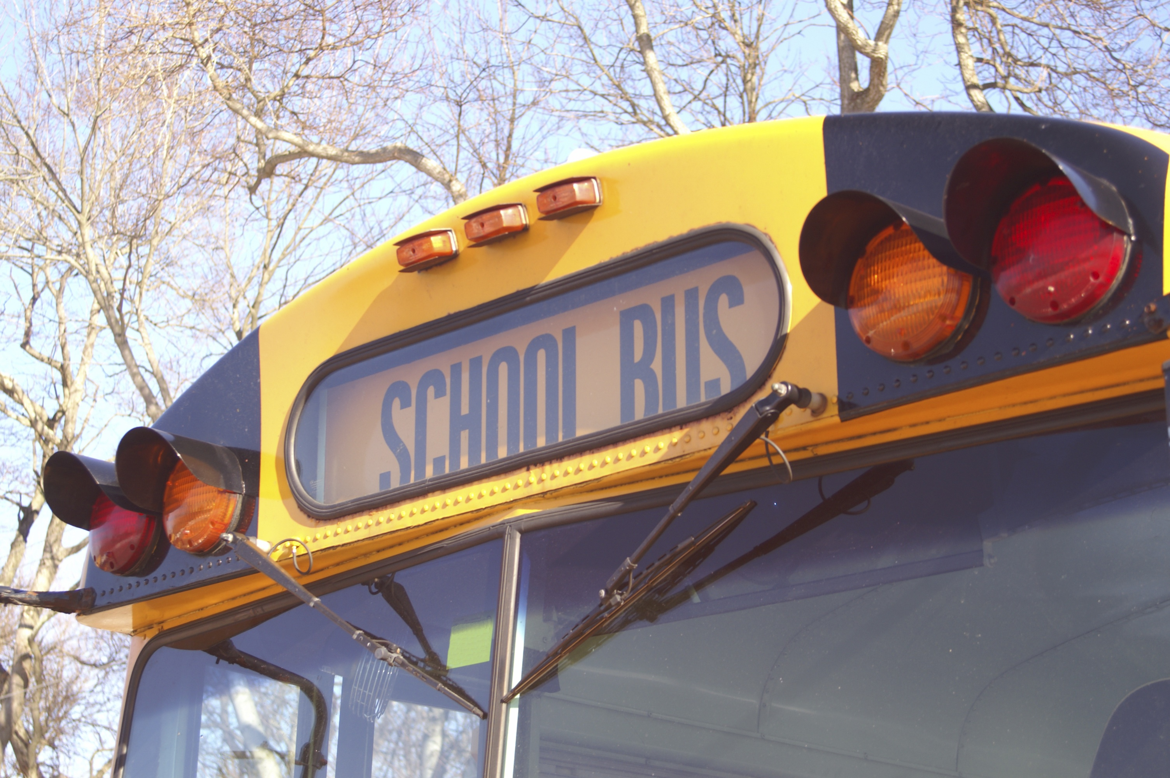
Overview
The Transportation Department at Sample Community Schools plays an integral role in the support of the educational process helping every child achieve.

Slide 3
We transported XXX students in 2012-2013 school year
Covered XXXX miles without injury
We did this with XXX buses and XXX drivers

Slide 4
We covered X routes
Made up of
X Elementary runs
X Secondary runs
X Special Needs runs
X Voc Ed runs
We also provided X extra trips
X Athletic events
X Field trips
Other?
Notes:
Consider adding additional miles traveled for athletic and field trips. May want to do another slide.
Explain routes and runs

Slide 5
Maintenance
We maintain our buses with X mechanics
We performed X number of oil changes
Other significant maintenance tasks??
Our inspection results this year were XXX

Slide 6
Safety
Our drivers receive extensive training to ensure safe driving and student management skills
They inspect over 200 parts on their buses to ensure safe operation prior to each route

Slide 7
Qualified Drivers
List various requirements that drivers must accomplish in order to drive a school bus
Any employee recognition??

Slide 8
According to the American School Bus Council:
Safety: School buses are the safest form of transportation for students – and many times safer than riding in the family car.
Traffic: Every child riding a school bus represents one fewer car on the road, especially in the congested area in and around schools, where children are at highest risk.
Environment: Students riding in the school bus instead of the family car means fewer car trips and less pollution.
School buses are school readiness vehicles, providing free access to an education for millions of children in America through healthy, safe and secure transportation to schools. Every day, more than 480,000 school buses deliver 26 million students to school safely and reliably, so they arrive at school ready to learn. All told, school buses provide over 10 billion passenger trips each year.

Slide 9
Environmental Contribution in Our Community
Cost of fuel for transporting one private vehicle making two round trips to school $378
Total daily car mileage saved by students riding school buses 40,000
Total annual car mileage saved by students riding school buses 7,200,000
Notes:
Use calculator from American School Bus Council - http://americanschoolbuscouncil.org/index.php?page=fuel-calculator

Slide 10
Total annual car fuel savings by students riding school buses (gallons) 360,000
Total annual car fuel COST savings by students riding school buses $756,000
Total community savings in fuel by students riding school buses (gallons) 317,143
Total community savings in fuel cost per year by students riding school buses $670,286

Slide 11
Operating Strategies
Review routes each year
Analyze Bus Stops for safety and efficiency
Analyze environment for safety, i.e., crossing busy streets, railroad tracks, etc.

Slide 12
Striving for Efficiency
Steps we’ve taken to reduce costs:
Bid fuel cooperatively
Decreased number of stops
Increased walking distances
Results of these efforts
Reduced number of buses required – saving $40,000 per bus
X buses reduced = $X saved
Notes:
Consider putting in personnel costs saved by various efficiency strategies

Slide 13
Special Accomplishments
Employee Recognition
Department Recognition
New School Year rider education programs

Slide 14
Flow Chart
Bob Sample
Director
1.
Mary Smith
Dispatcher
20 Drivers
2 Full time maintenance

Slide 15
Questions?

